Slide 1
s
e
c
o
n
d
C
O
R
N
A
N
I
T
H
I
S
12.7-22
A free CD of this message will be available following the service
It will also be available for podcast later this week at calvaryokc.com

Slide 2
Alcohol
Cig. smoke
Lard
Soil
O
A
N
S
12.7-22
I
I
s
e
c
o
n
d
C
R
N
T
H

Slide 3
O
A
N
S
12.7-22
I
I
s
e
c
o
n
d
C
R
N
T
H

Slide 4
Thorn - skolops
A pointed piece of wood, a pale, a stake
O
A
N
S
12.7-22
I
I
s
e
c
o
n
d
C
R
N
T
H

Slide 5
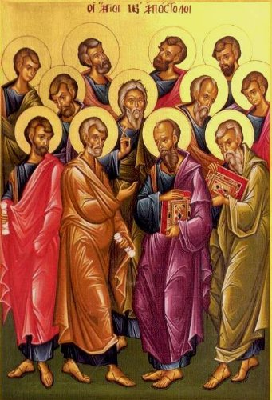
Apostle
monthly
Vol. 777
An exclusive interview with the Apostle Peter
His views on:
Paul’s thorn revealed!
Mood lighting
Hillsong
To sit or stand
and so much more!
(Pg. 13)
2 Corinthians 11 diet
10 pounds in
10 days … GUARANTEED!
O
A
N
S
12.7-22
I
I
s
e
c
o
n
d
C
R
N
T
H

Slide 6
O
A
N
S
12.7-22
I
I
s
e
c
o
n
d
C
R
N
T
H

Slide 7
Said - 3rd person, active voice, perfect tense
Rest - episkēnoō
epi (upon) - skēnoō (verb form of tent or tabernacle)
To spread a tent over
P. T. Forsyth (1848-1921) - “It is a greater thing to pray for pain’s conversion than its removal.”
O
A
N
S
12.7-22
I
I
s
e
c
o
n
d
C
R
N
T
H

Slide 8
O
A
N
S
12.7-22
I
I
s
e
c
o
n
d
C
R
N
T
H

Slide 9
NASB, NIV - If I love you more, will you love me less?
O
A
N
S
12.7-22
I
I
s
e
c
o
n
d
C
R
N
T
H

Slide 10
O
A
N
S
12.7-22
I
I
s
e
c
o
n
d
C
R
N
T
H

Slide 11
Contentions - KJV, debates
O
A
N
S
12.7-22
I
I
s
e
c
o
n
d
C
R
N
T
H

Slide 12
Outbursts of wrath - thumos – passionate anger
O
A
N
S
12.7-22
I
I
s
e
c
o
n
d
C
R
N
T
H

Slide 13
Selfish ambitions - eritheia – gaining political office by unfairness
Politicking
O
A
N
S
12.7-22
I
I
s
e
c
o
n
d
C
R
N
T
H

Slide 14
Backbitings - katalalia
kata - against; laleō – to speak
O
A
N
S
12.7-22
I
I
s
e
c
o
n
d
C
R
N
T
H

Slide 15
Whisperings - psithos – psst
NASB, NIV - gossip
O
A
N
S
12.7-22
I
I
s
e
c
o
n
d
C
R
N
T
H

Slide 16
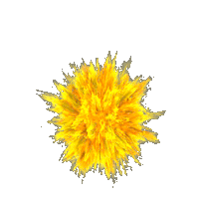
Conceits - phusiosis – to inflate, to cause to swell up
O
A
N
S
12.7-22
I
I
s
e
c
o
n
d
C
R
N
T
H

Slide 17
Tumults - akatastasia – a (un) - kathistēmi (to set in place)
To cause to be unstable
O
A
N
S
12.7-22
I
I
s
e
c
o
n
d
C
R
N
T
H

Slide 18
2 cor. 12.20
1 cor. 13.4-6
Contentions
Does not behave rudely (v. 5)
Jealousies
Love does not envy (v. 4)
Outbursts of wrath
Is not provoked (v. 5)
Selfish ambitions
Does not seek its own (v. 5)
O
A
N
S
12.7-22
I
I
s
e
c
o
n
d
C
R
N
T
H

Slide 19
2 cor. 12.20
1 cor. 13.4-6
backbitings
Is kind (v. 4)
Does not rejoice in iniquity but rejoices in the truth (v. 6)
Whisperings
conceits
Does not parade itself, is not puffed up (v. 4)
Tumults
Thinks no evil (v. 5)
O
A
N
S
12.7-22
I
I
s
e
c
o
n
d
C
R
N
T
H

Slide 20
O
A
N
S
12.7-22
I
I
s
e
c
o
n
d
C
R
N
T
H

Slide 21
Three lessons of Paul's experience:
1. A healthy body is not the apex of the Christian life
2. Sickness is not the result of a lack of faith
3. It is far worse to be in sin than in sickness; pride is the greatest of all sins
O
A
N
S
12.7-22
I
I
s
e
c
o
n
d
C
R
N
T
H

Slide 22
O
A
N
S
12.7-22
I
I
s
e
c
o
n
d
C
R
N
T
H

